Slide 1

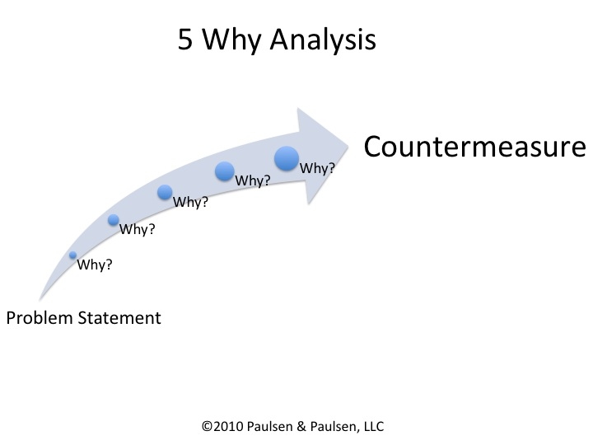
5 WHY’s Analysis
Why do it?
Allows you to identify the root cause instead of the symptom of a problem, so that the fix prevents recurrence of the issue.
What does it do?
5 Whys analysis is a method of breaking down the problem, asking ‘Why?’ enough times to determine the root cause.
It uses a brainstorming technique that asks WHY events occurred or WHY conditions existed.
By selecting one event associated with an action this technique produces the most direct cause for each event. Then, for each of these causes or sub events in turn you need to ask why that happened.
It has been found that by the time you ask ‘Why?’ 5 times & got 5 sensible answers, you can normally see where the problem originated, thereby enabling you to treat the root cause rather than the symptoms.
How do I do it?
Write down the problem which causes the biggest waste. You may want to do this in conjunction with a Fishbone diagram, IRD or Pareto chart. For each major effect ask ‘Why?’ and record the causes.
Example of using 5 Whys to discover Root Cause
There is a damp patch on the ceiling
Because water is dripping through the roof
Because there is a hole under the eaves
Because birds have been nesting there
Because they can’t nest in the trees
Because there are no trees tall enough for them
to stay out of the way of the cat!!
Counter Measure: So need to secure hole in eaves, provide birdhouse that cat can’t get to.
1. Why?
2. Why?
3. Why?
4. Why?
5. Why?
TIP
Ensure that the 5 Whys still makes sense
when you read them backwards!

