Slide 1

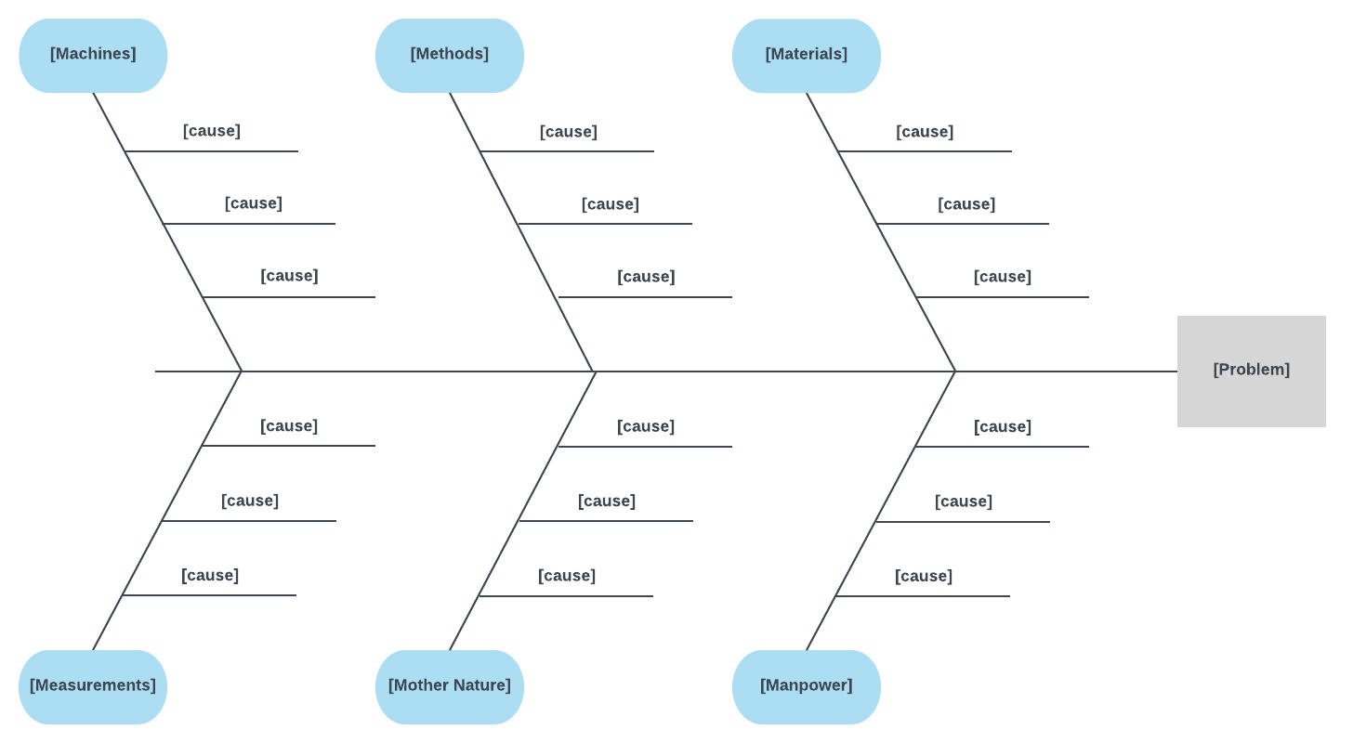
Fishbone (Ishikawa)
Diagram
To determine the root cause(s) of the problem so that solutions will have an impact on the real problem and not just the effects of the problem. .
Where Do I Start?
Devise the Problem Statement that best describes the issue you want to determine the root cause of.
This statement should be Specific and Measurable in order to provide focus:
What is wrong with what?
How is it a problem for us?
What is the impact ($/time etc)
The problem statement needs to be clear and understood by everyone.
Write the problem statement at the head of your fish
For example: Late Pizza deliveries on Fridays and Saturdays.
Brainstorm all the possible causes and write each cause on a separate post it note. Make sure that all the suggestions are causes and not solutions!
Sometimes it’s easier to think about causes using certain categories:
People Equipment
Policy Information
Process Management System
Remember the brainstorming rules:
No criticism
Record all ideas
Build on the ideas of others
Creativity is the key!
Next , review all the causes and start grouping similar causes together, give these categories titles. Make sure the categories reflect the problem. Add these titles and causes post its to the bones on the fish.
Some causes may fit more than 1 category. Place them in all the relevant categories. This could help to identify the root cause.
Now that the fishbone has been completed, the team have a better understanding of the problem and all the possible causes.
The next step is to interpret or test for root cause. There are several ways of checking this:
Look for causes that appear repeatedly within or across major categories
Gather data to prove or disprove the effect of a possible cause
Use the IRD or 5 Why’s technique on specific causes to reach a root cause

