Slide 1
Gemba WITH PURPOSE
HOW TO GUIDE AND TEMPLATE
MARCH 2020

Slide 2

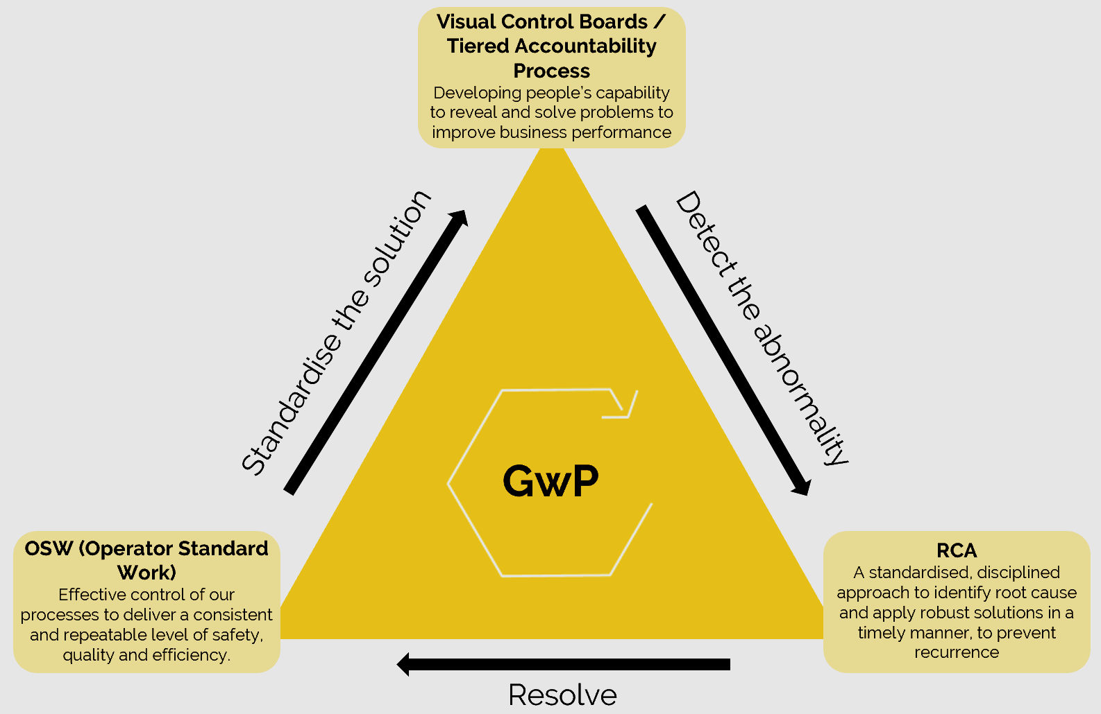
Gemba WITH purpose – One pager
Definition
Gemba with a Purpose is a process by which all leaders ‘go see’, coach and develop their people to solve problems to deliver business goals.
Purpose
How to do it
To ‘go see’ and confirm what is happening (against the standards) at the place where work is done.
To ensure that standards for the 4M’s (Man, Material, Method, Machine) are in place and in use resulting in performance moving towards performance goals.
To align and engage the teams around the delivery of business goals .
To develop people to reveal and solve problems to deliver business goals.
What will you be observing?
What is the current state?
What is the next target condition for this site/area?
What problems need to be overcome or improvements made?
Coach, then take action
Can I answer these 3 questions:
What have I learned?
What have I taught?
What have I improved?
Tools
4M’s as a model to manage the fundamentals of Safety, Quality, Cost and Service
Target Condition
Coaching
Process confirmation
Gemba Guide
Expected outcomes
What good looks like
Priority problems and improvement opportunities identified
Raised capability to deliver business goals
Aligned and engaged people delivering Continuous Improvement
Coaching - Managers developing their people by getting them to solve problems by thinking for themselves

Slide 3
The 4M’s Explained (I)
The pattern and cycle of work that is carried out. Standardised to provide good quality product at the right cost, in the safest manner and to the necessary cycle time.
Equipment that is fit for purpose for the job that is required to carry out. Set up in a standard way and appropriately maintained to produce good quality product at the right cost, capable of being operated safely and with the required cycle time.
MAN
MACHINE
Production Process
MATERIAL
MGMT METHOD
Material and components that are suitable for the product being produced. Of the appropriate characteristics to produce good quality product and presented to the ‘Man’ in a manner that permits work to be carried out safely and efficiently.
The Management method is focussed on creating the local culture to effectively manage safety, quality, cost and service. It is concentrated on the shop/office floor and is focussed on continuous improvement, rather than fire-fighting.

Slide 4
The 4M’s Explained (II)
MAN
MACHINE
Production Process
MATERIAL
MANAGEMENT METHOD
If all the inputs are varying, how can you get predictable output?
To improve our performance, leading to better cost, quality, service and safety, we have to control the 4M’s.

Slide 5
The 4M’S explained (III)
Principles
Key questions
Is standard work based on standard rate?
Is there a clear trigger when cycle starts?
Is any wait time clear and visible?
Man
Work balanced to run rate
Work clearly standardised
Is there a clear work pattern with defined cycle?
Is cycle repeated without disruption?
Does each person perform tasks in the same way?
Management method
Management activity focussed on delivering desired outcomes through identifying, standardising and managing barriers
Are data, observations and interviews used to clarify problems? Or is data used alone ?
Are preventative maintenance and equipment standards used to prevent break downs? Or is all resource responding to breakdowns?
Are there clear and specific settings for machinery? Or is there dependency on unique individual skills?
Material
Material flow around the operator should minimise movement and transport
Is material presented in a way to support standard work?
Is there a trigger for material replenishment? Does it work?
Is there a trigger for material removal from the line? Does it work?
How are materials stored on and offline (5S principles)?
Is there visual control to start/stop production (e.g. staging area)?
How do management prepare and support next job?
Is all of this visible at a glance (visual control in place)?
Machine
Machine has standard settings which are adhered to
Are there standard settings? Are these visible and in use (are numbers correct today)?
When were settings last reviewed and updated?
Machines are maintained to clear plan
Is preventative maintenance plan visible? Are tasks completed up to date? If not, is there a clear plan?
When was the schedule last reviewed and updated?

Slide 6
Gemba Template & how to guide
A Gemba should always be prepared for. Doing a walk around without a purpose will be inefficient and counterproductive.
1. Fill in study details, including which area you will visit
2. Determine the focus for the Gemba
Completed by:
Date:
Area:
Focus:
4. Go to the Gemba – note down your observations
Observations (During):
Before (preparation):
3. Plan the walk – be specific
What are you looking to find?
Who are you going to coach?
How are you going to learn?
5. After the Gemba reflect on your observations and discussions – generate corrective actions, provide feedback and escalate where applicable
Actions (after):

Slide 7
Gemba Template
A Gemba should always be prepared for. Doing a walk around without a purpose will be inefficient and counterproductive.
Completed by:
Date:
Area:
Focus:
Observations (During):
Before (preparation):
What are you looking to find?
Who are you going to coach?
How are you going to learn?
Actions (after):

Slide 8
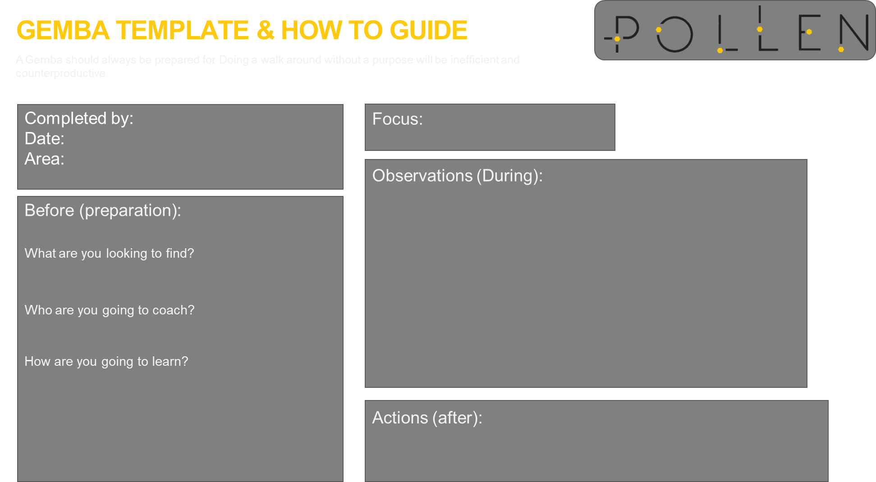
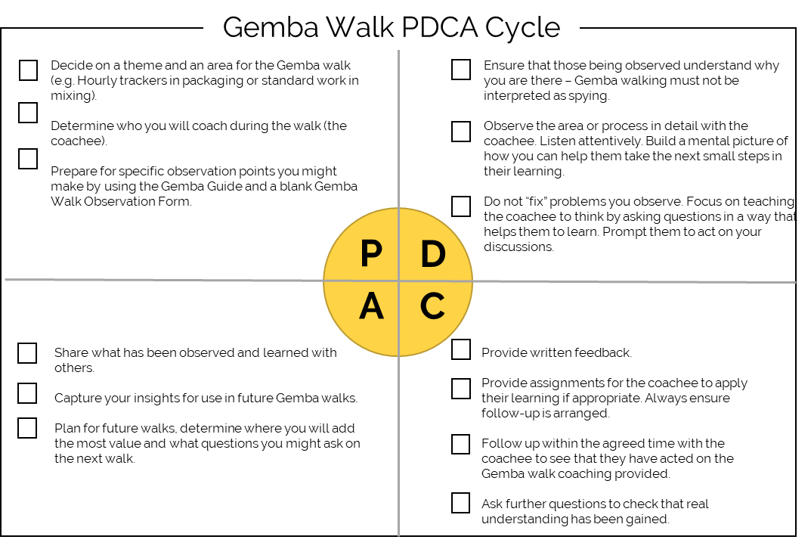
Gemba with purpose | step by step
Gemba Walk Forms
Gemba Walk Guide Questions
Poor Questions | Right Questions
What can we do? | Show me what should be happening (the standard)
Is everything alright? | What is actually happening? Why is there a difference? What are the causes? How do you know? Please show me at the line / machine
When will you be done? | Where are we supposed to be at this point? (the plan)
Is everything on track? | Why is there a difference? What are the causes? How do you know? Please show me at the line / machine What is preventing the operator from achieving the standard? What Is the biggest obstacle / problem? What is it about our system that enables this to happen? What is the improvement target?
Good job! | What did you learn?
We need more of this | What are the remaining obstacles? What should we do differently?
What did I learn?
What did I teach?
What did I improve?
Gemba PDCA
Reflection

Slide 9
Contact
Why Pollen Consulting Group? Being a fresh and new business, allows us to challenge the consultancy model, building a new level of competency. Pollen is driven to make a difference.
POLLEN CONSULTING GROUP
+61 (0) 282 268 748
Level 26, Bligh St Sydney 2061
paul@pollenconsultinggroup.com

